Slide 1
Keeping your children safe with technology
Information for parents
Offenham CE first school
13.7.17

Slide 2
Key information
*Look at how children use the internet
*Raise awareness of eSafety issues
*Offer guidance on how to help keep children safe online

Slide 3
Benefits of technology for children:
  fun
  educational
  can help raise standards
  helps build creativity
  enables communication with friends and family

Slide 4
“70% of parents feel that their children know more about the internet than they do”
(Ofcom Media Literacy 2011)

Slide 5
Some of the technologies…
Mobile phones
What next
???
Instant
messaging
BLOGS
Social
networking
Music
Download
sites
E-mail
Gaming sites
Podcasting
Wikies
Chat Rooms
Video
broadcasting
P2P
file-sharing
Text

Slide 6

WHAT ARE THEY USING THEIR MOBILE PHONES FOR?
Anytime ⬄ Anywhere
Camera phones
Text messages
Internet access
e-mail
MP3 player
Chat and IM
Downloads
Mobile TV

Slide 7
Risks
Children make online ‘friends’ and chat to people who are unknown who may pose a risk to them
Children may upload or view inappropriate material
Sharing files can lead to spyware, identify theft and greater vulnerability to viruses.
Risk of cyber bullying

Slide 8
School approach to E-safety
Safe: keeping personal information safe
Meeting: online friends are strangers
Accepting: be aware of viruses
Reliable: information may be untrue
Tell: inform an adult

Slide 9
School Home
Supervised
Monitored
Filtered
Curriculum
?
Rise of smartphone and ipad

Slide 10
Access to technology
WHERE?
Internet agreements
with your child
Limit time using technology
Think about where they use technology - webcams
Take technology at night
WHEN?
¼ of children admitted to missing sleep because of technology
2/3s of children said using technology interrupted time doing schoolwork and spending time with friends and family

Slide 11
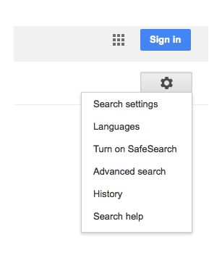
What to do?
Check history of websites children have viewed
Turn on Safe Search in Google

Slide 12
Encourage use of child friendly search engines e.g. Yahooligans and KIDREX
Use safe search apps on iphones and ipads e.g. K9 browser
Think about when your child needs a mobile phone. Contact the provider to put restrictions on usage.

Slide 13
Make sure you use a firewall and have anti-virus software
Set up a family email for websites children access
Encourage children to not use a nickname on sites and not share personal information

Slide 14
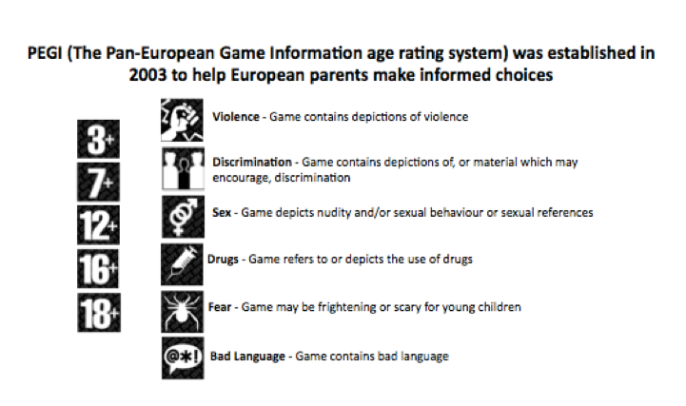
Gaming
Massively multiplayer online role playing games
Talk to children about playing with strangers and giving personal information

Slide 15











Social
networking
18% of 9 to 10 year olds and 25% of 11 to 12 year olds have a Facebook profile
14% accept all friends
Only half keep their profiles private
¼ give a false age
3% meet up with someone online that they have never met
Notes:
A social network is an online community that can chat, have a notice board and generally communicate with “friends” . These networks are part of many peoples, especially the young, daily lives There are hundreds of social networking sites on the web. Some are aimed at professionals and focus on work related topics. Many other are aimed at young people and have vast populations In the UK Friends Reunited was one of the early social networking sites. It was based on shared history, such as school friends and has been used as a model for most social networks which have now evolved to incorporate a very wide and diverse group of “friends” The etiquette on these sites is to post information about yourself which is totally against ALL eSafety advice.
Bebo, MySpace, facebook are not accessible in school together with any other known sites. There are many other similar sites with new ones springing up every day and it is often possible to get round most filtering to access these networks.
New research from USA indicates that 61 per cent of 13 to 17-year-olds have a personal profile on websites such as MySpace. Half of those have also posted pictures of themselves online.

Slide 16
Ban or Educate?
Facebook and most other social media sites are for over 13 year olds.
Build a profile with your child. Discuss what personal information to share.
Set a strong password.
Become your child’s friend.
Discuss which photos are appropriate to post and how they can be misused.
Explain that friends should be people they know.
Set strong privacy settings to friends only.

Slide 17
For more information…..
https://ceop.police.uk/safety-centre/
http://www.parentscentre.gov.uk/
www.thinkuknow.com
http://www.getnetwise.org/
http://www.childnet-int.org/
http://www.bbc.co.uk/webwise/
http://www.iwf.org.uk/
http://www.internetmatters.org/age-guides/videos.html
http://facebook.com/safety

Slide 18
Useful safe websites for links across the curriculum, including games and general resources:
  http://www.bbc.co.uk/schools/parents/
  http://www.topmarks.co.uk/
  http://www.woodlands-junior.kent.sch.uk/Games/
  http://www.bgfl.org/bgfl/15.cfm?s=15&p=251,index
  http://www.bbc.co.uk/schools/
  http://durham.schooljotter.com/coxhoe/Curriculum+Links

Slide 19

WHAT CAN I DO RIGHT NOW?
Open dialogue with your child
Family agreement
Consider filtering and blocking software
Think before you/they post
Understand the laws
Privacy settings and reporting
Save the evidence and report the incident
Know where to get help
Watch SID TV clips

