Slide 1


Year 1 Parents’ Meeting

Slide 2
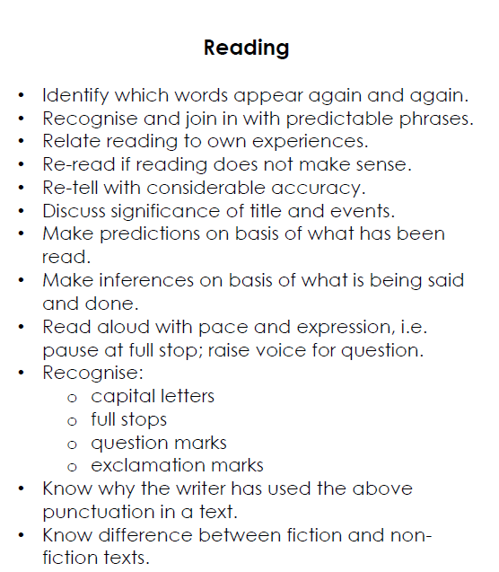
Comprehension
Reading
Expectations
Children should be reading at least 3 times a week.
School books are to imbed phonics.
Books that interest your child are encouraged as well.
Write any reading you do in the yellow book.

Slide 3
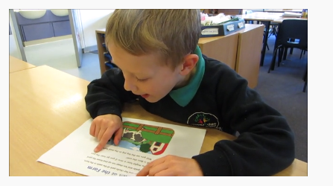
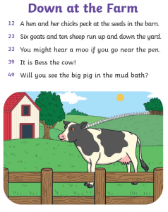
What does the expected level of reading look like in year one?
Reading
Greater Depth
Comprehension and fluency

Slide 4
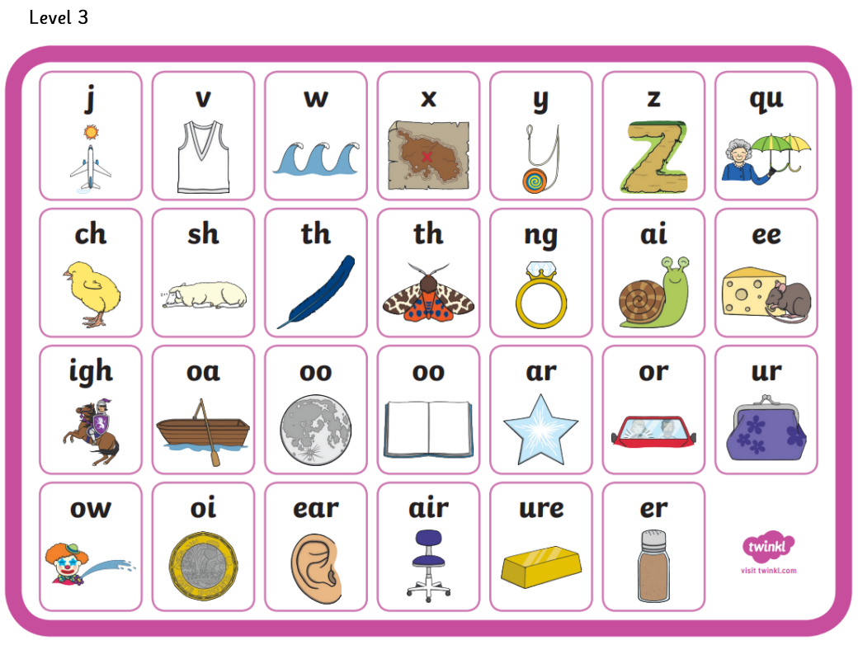
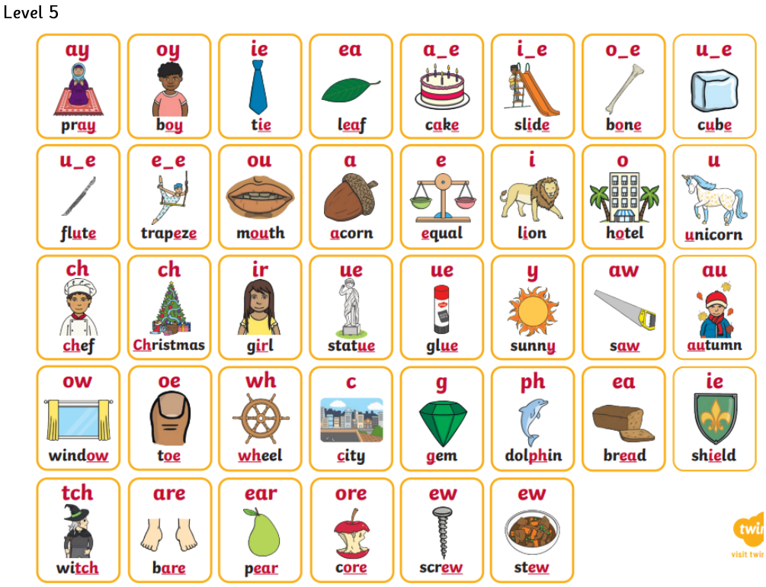
Phonics

Slide 5
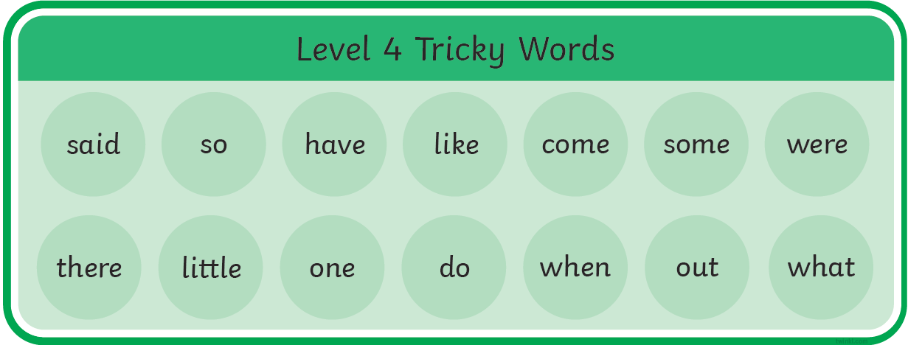
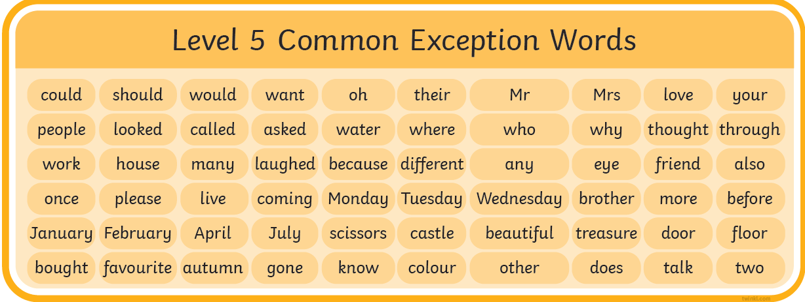
Reading
Common Exception Words

Slide 6
Writing
Independently, I can…
Leave spaces between words.
Join words and clauses using and.
Begin to punctuate using a capital letter, full stop, question mark and exclamation mark.
I can use a capital letter for names of peoples, places, days of the week and I
I can use my learned phonics in my spellings
I can spell common exception words and days of the week
I can add prefixes and suffixes e.g. –un –ed –ing –s –es
I can begin to form lower case letters correctly, starting and finishing in the right place
I can form capital letters
I can form digits from 0-9
I can write a short narrative by sequencing sentences
I can re read what I have written to check it makes sense
I can discuss what I have written with my teacher/peers
Writing

Slide 7
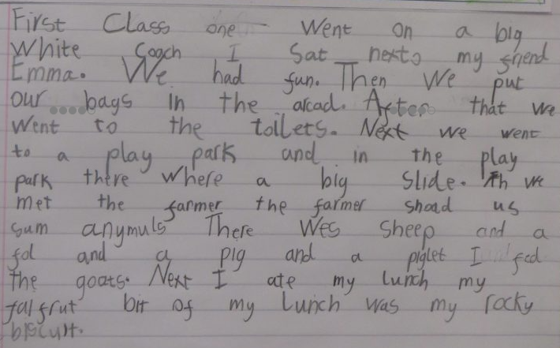
What does the expected level of writing look like in year one?
Writing

Slide 8
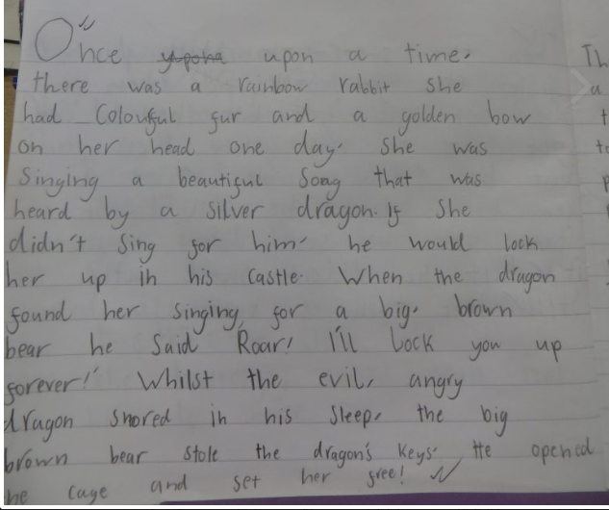
What does working at greater depth of writing look like in year one?
Writing

Slide 9
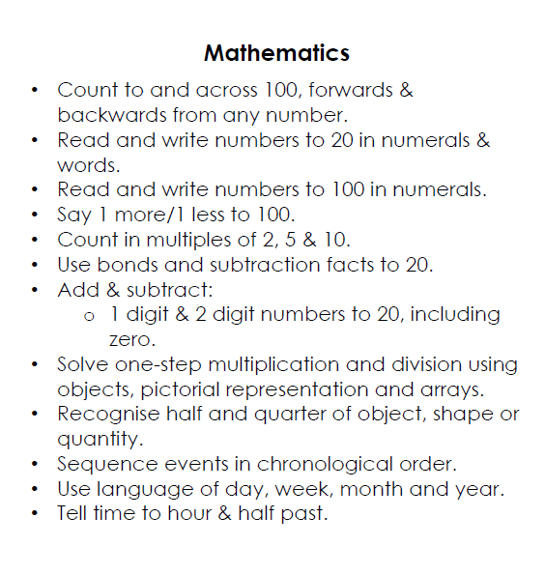
Maths

Slide 10
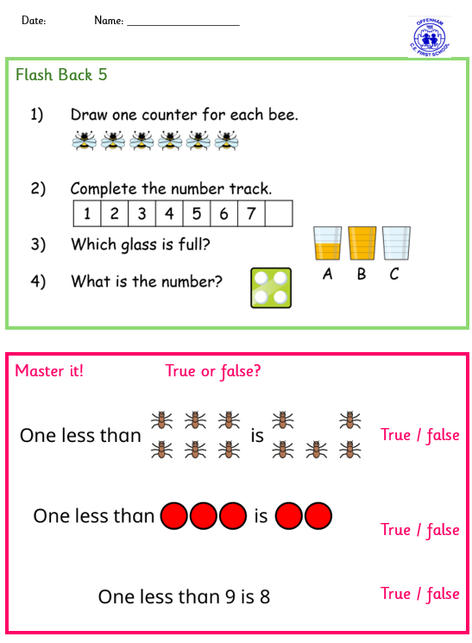
Maths
Maths Lesson Structure
Flash back
New learning – practical/written
Master it

Slide 11
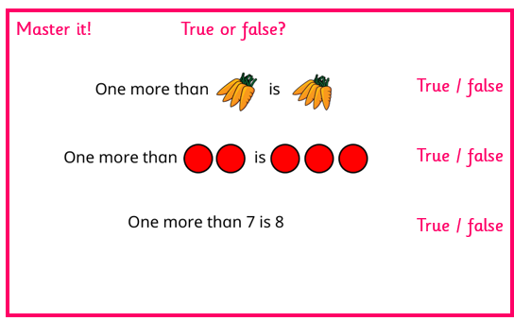
Mastery (in maths)
Instead of moving quickly through lots of topics, children spend time really understanding each concept deeply before moving on. They learn it in different ways — using objects, pictures, and numbers — so they truly understand why something works, not just how to do it. This means fewer children are left behind, and those who grasp things quickly go deeper rather than rushing ahead.
Oracy
This is about teaching children to talk and explain their thinking out loud, using the correct mathematical language. Rather than just writing an answer, children are encouraged to say things like "I know this because..." or "I predict that... because...". Talking things through helps children understand ideas more deeply and builds their confidence.
A simple way to frame both together on a slide: "We don't just want children to get the right answer — we want them to deeply understand it, and be able to explain it."
Maths

Slide 12
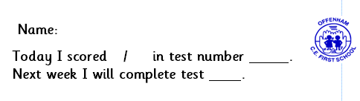
KS1 Mental Maths
To prepare children for Ks2 Times Tables Tests in Year 4
First test – Tuesday 24th September
Must get all the questions correct to move onto the next test
A sticker will be in their reading record with their score each week
Parents will be informed when their child needs to learn the new test
Maths

Slide 13
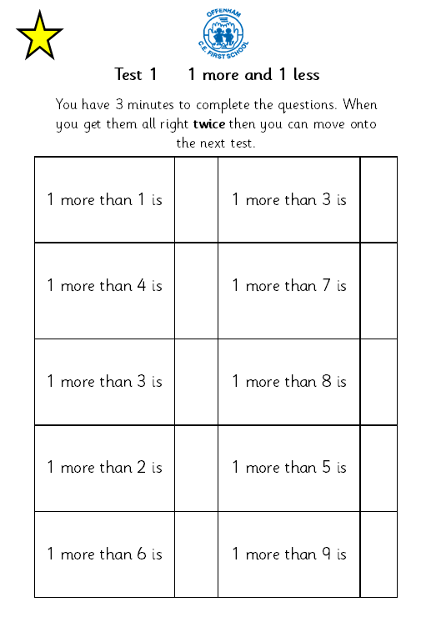
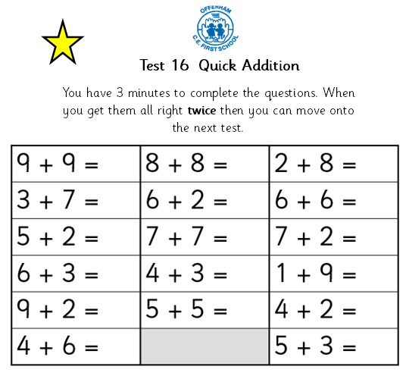
KS1 Mental Maths
Maths

Slide 14
Online Safety

Slide 15
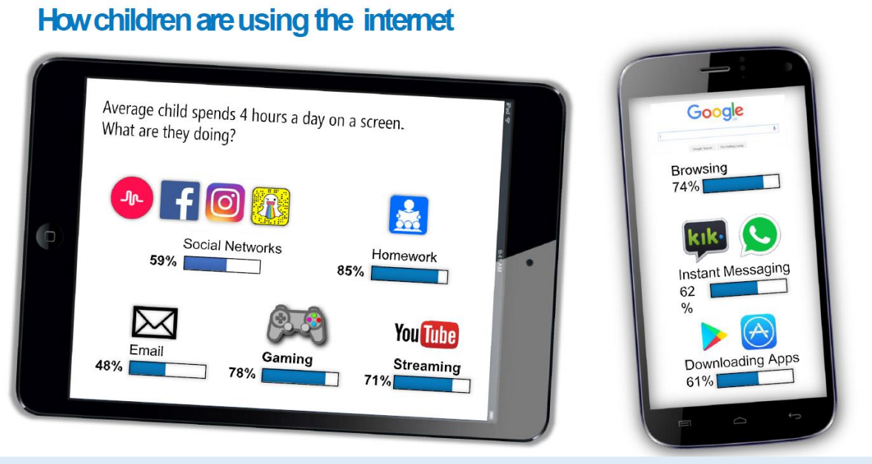
Online Safety

Slide 16
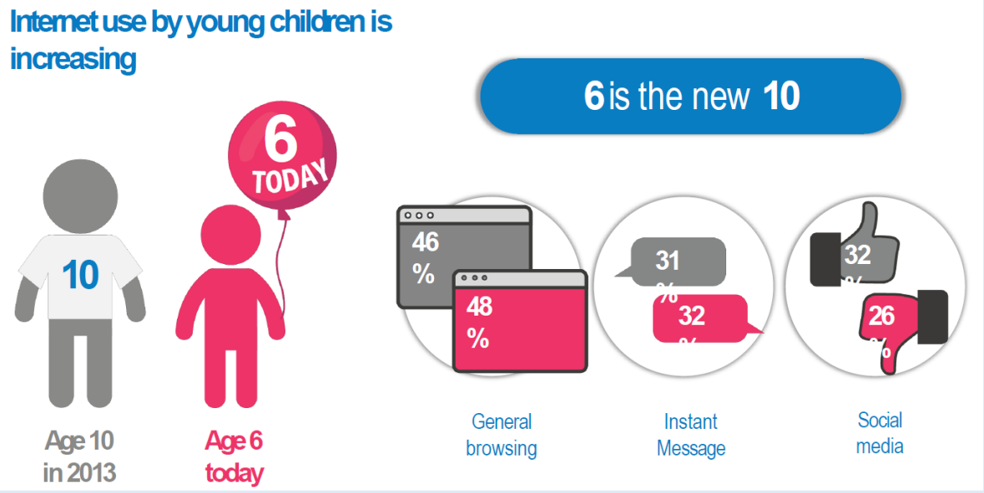
Online Safety

Slide 17
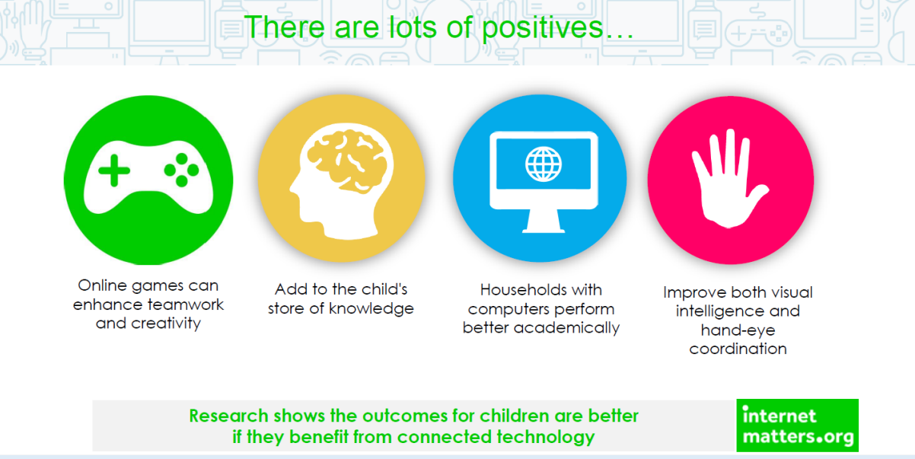
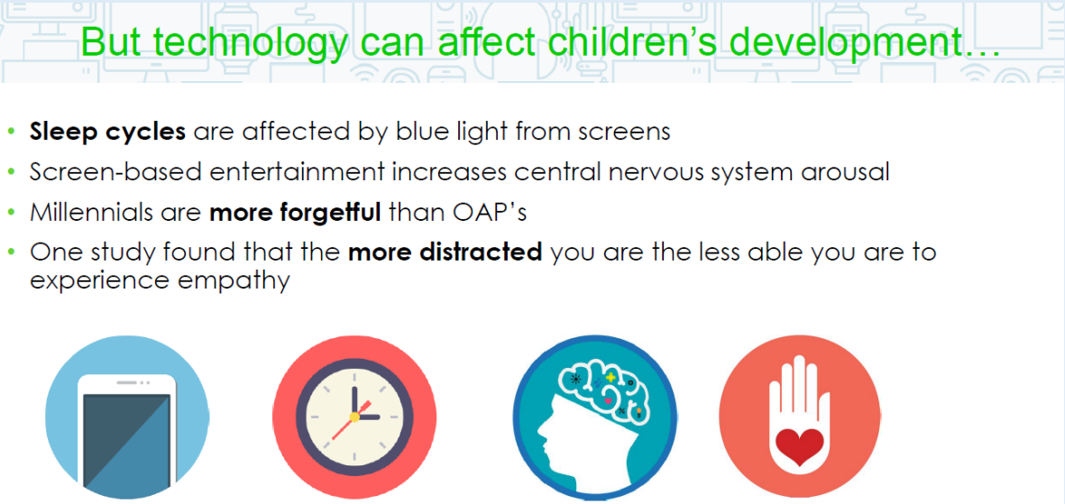
Online Safety

Slide 18
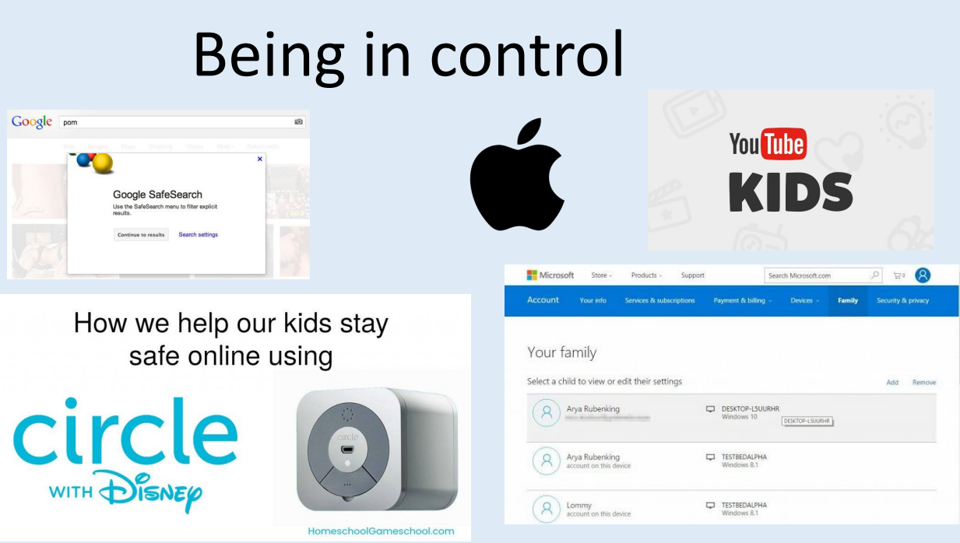
Online Safety

Slide 19
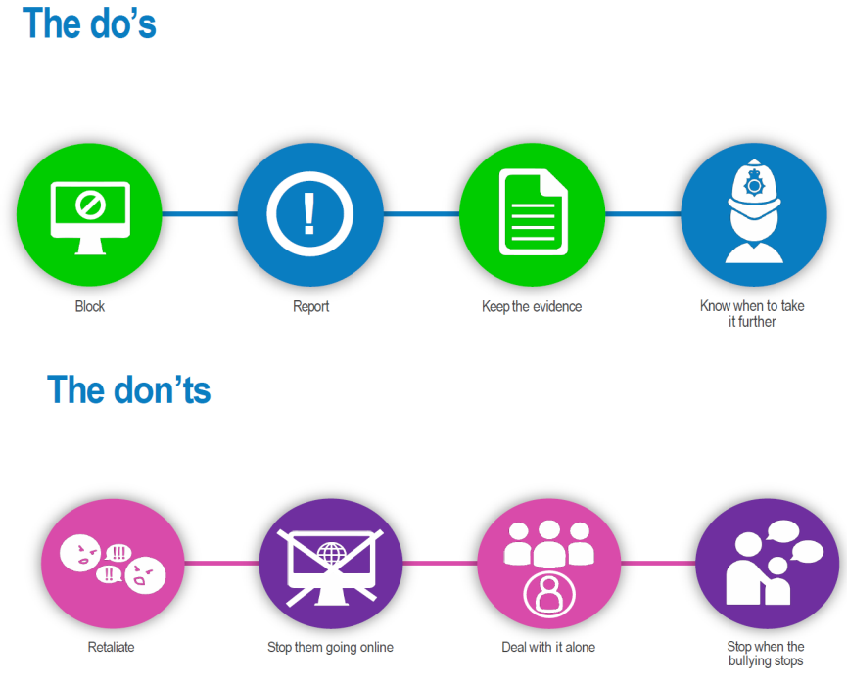
Online Safety

Slide 20
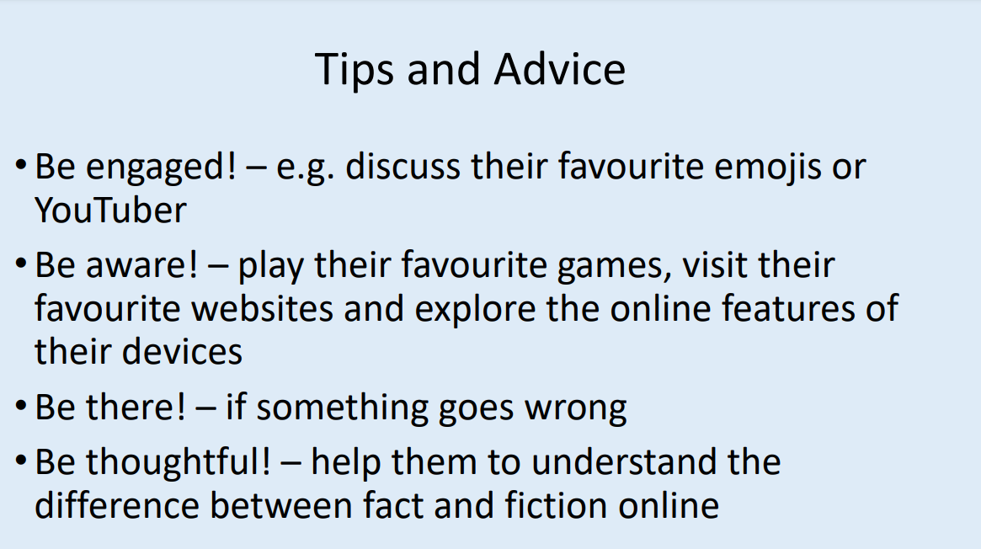
Online Safety

Slide 21
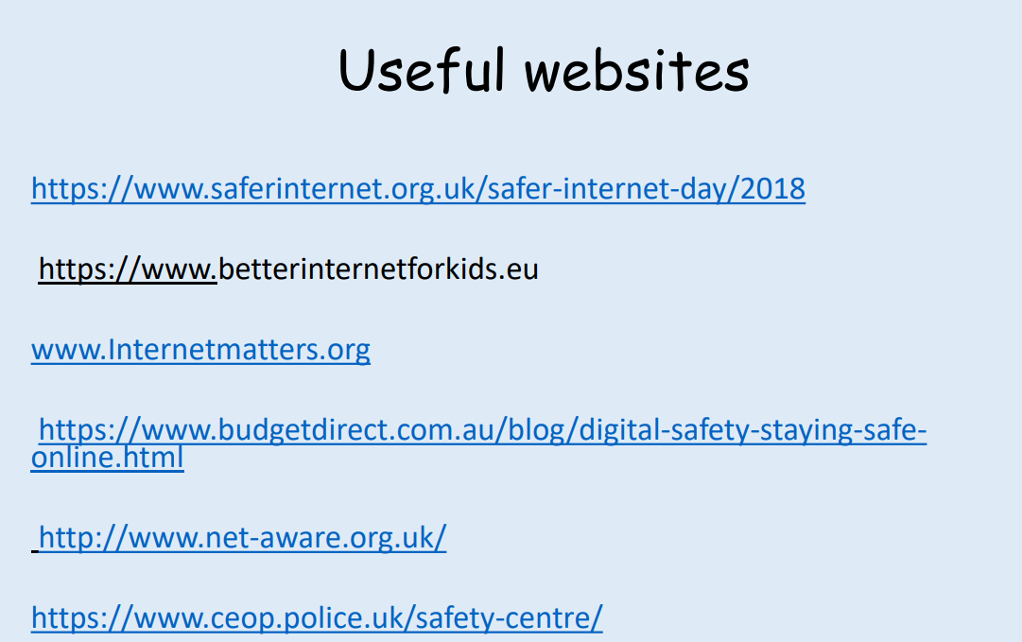
Online Safety

